Slide 1
UPPER SIXTH ARTS
GEOGRAPHY
Field Work 5
Fieldwork in Biogeography: Soils and Vegetation
Notes:
Good morning, class, and welcome to our geography lesson. I am your geography teacher, Mr Kamdem. Today we are starting Field Work 5: Fieldwork in Biogeography: Soils and Vegetation.

Slide 2
CLASS INFO
Class, Chapter and Duration
Class | Upper Sixth Arts
Chapter | Module 8: Understanding and carrying out statistical techniques, topographic map analysis, fieldwork and project based learning
Duration | 2 periods (2 × 50 minutes)
Notes:
This lesson is for Upper Sixth Arts. It belongs to Module 8: Understanding and carrying out statistical techniques, topographic map analysis, fieldwork and project based learning. We shall need 2 periods to cover it.

Slide 3
IDENTIFICATION
Lesson Identification
Topic | Fieldwork in Geography
Sub-topic | Field investigations in physical geography
Lesson | Field Work 5: Fieldwork in Biogeography: Soils and Vegetation
Notions / Concepts | Soil profile, horizon, soil pit, auger, transect, quadrat, kite diagram, percentage cover.
Syllabus focus | Soil profile and variation with depth or along a slope; soil erosion; vegetation density, structure and species along a transect with quadrats.
Competence | Learners are able to describe soil profiles and sample vegetation along a transect.
Notes:
Our topic is Fieldwork in Geography, and the sub-topic is Field investigations in physical geography. The key notions we shall use today are: soil profile, horizon, soil pit, auger, transect, quadrat, kite diagram, percentage cover. At the end, you should be able to do this: learners are able to describe soil profiles and sample vegetation along a transect.

Slide 4

HOMEWORK CORRECTION
Correction of the Homework
Question (Field Work 4: Fieldwork in Geomorphology: Rivers and Coasts):
Draw the long profile of a local stream using heights from a map.
Notes:
Before we start the new lesson, let us correct the homework I gave you at the end of Field Work 4: Fieldwork in Geomorphology: Rivers and Coasts. The question was: Draw the long profile of a local stream using heights from a map. Take out your exercise books.

Slide 5
HOMEWORK CORRECTION
Correction: Possible Answer
Read the heights where the stream crosses each contour and the distance from the source. Plot distance (x) against height (y) and join the points: the curve is steep near the source and gentle downstream.
Notes:
Here is a good answer. Read the heights where the stream crosses each contour and the distance from the source. Plot distance (x) against height (y) and join the points: the curve is steep near the source and gentle downstream. Compare it with your own answer and correct your work in red.

Slide 6
LESSON PLAN
Lesson Plan
Correction of the homework
Objectives and recall
Real-life situation and action to take
Learning activities
Board summary
Evaluation, remediation and homework
Notes:
Here is the plan of our lesson today. First, we shall correct the homework. Then we shall look at the objectives and recall what you already know. After that, we shall study a situation from real life and the action to take, and do the learning activities. Finally, we shall copy the board summary, do the evaluation and the remediation, and I will give you the homework.

Slide 7
OBJECTIVES
Objectives
By the end of this lesson, you should be able to:
Describe a soil profile and test soil properties.
Sample vegetation with quadrats along a transect.
Notes:
Take your time to copy this part; we will continue together.

Slide 8
OBJECTIVES
Objectives (continued)
Present results with a kite diagram.
Notes:
By the end of this lesson, you should be able to do three things. Number 1: describe a soil profile and test soil properties. Number 2: sample vegetation with quadrats along a transect. Number 3: present results with a kite diagram.

Slide 9
PREVIOUS KNOWLEDGE
Previous Knowledge
Soil has horizons.
Vegetation changes with height and water.
Notes:
Let us first remember what you already know. Soil has horizons. Vegetation changes with height and water. Keep this in mind, because we shall build on it today.

Slide 10
REAL-LIFE SITUATION
Situation in Real Life
On a slope near the school, the grass is tall at the bottom near a stream and short at the top. The class wants to know how soil and vegetation change along the slope.
Notes:
Listen carefully to this situation from real life. On a slope near the school, the grass is tall at the bottom near a stream and short at the top. The class wants to know how soil and vegetation change along the slope. Think about it, because I am going to ask you some questions.

Slide 11
REAL-LIFE SITUATION
Situation: Question 1
What is the problem in the situation?
Notes:
Question 1: What is the problem in the situation? Think for a moment, then raise your hand to answer.

Slide 12
REAL-LIFE SITUATION
Answer
The class must explain changes along the slope.
Notes:
Good. The class must explain changes along the slope.

Slide 13
REAL-LIFE SITUATION
Situation: Question 2
Which tool samples vegetation?
Notes:
Question 2: Which tool samples vegetation? Think for a moment, then raise your hand to answer.

Slide 14
REAL-LIFE SITUATION
Answer
A quadrat.
Notes:
Good. A quadrat.

Slide 15
REAL-LIFE SITUATION
Situation: Question 3
What line is followed for sampling?
Notes:
Question 3: What line is followed for sampling? Think for a moment, then raise your hand to answer.

Slide 16
REAL-LIFE SITUATION
Possible Answer
A transect.
Notes:
Good. A transect.

Slide 17
ACTION TO TAKE
Action to Take
Study soils and plants in the field and protect them.
Notes:
From this situation, the action we are working towards in this lesson is the following: study soils and plants in the field and protect them.

Slide 18
JUSTIFICATION
Justification of the Lesson
This fieldwork helps us to study the links between soils and vegetation.
Notes:
Why is this lesson important for you? This fieldwork helps us to study the links between soils and vegetation.

Slide 19

1. SOIL PROFILE
Activity 1
A soil profile.
Notes:
Activity 1. Look carefully at this diagram: a soil profile. Observe every detail before I ask the question.

Slide 20
1. SOIL PROFILE
Activity 1: Question
Name the main soil horizons.
Notes:
Here is the question for Activity 1: Name the main soil horizons. Take one minute to think and write your answer in your rough notebook.

Slide 21
1. SOIL PROFILE
Activity 1: Answer
Topsoil (A), subsoil (B), weathered rock (C) and bedrock.
Notes:
Let us check the answer together. Topsoil (A), subsoil (B), weathered rock (C) and bedrock.

Slide 22
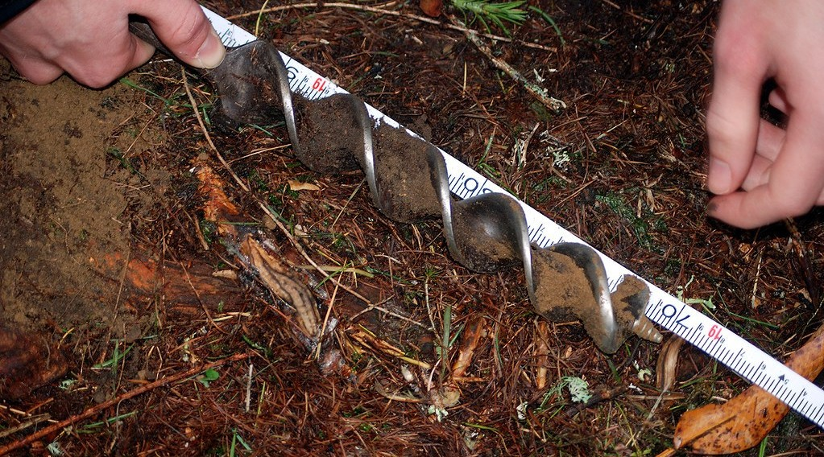
1. SOIL SAMPLING
Activity 2
Taking a soil sample.
Notes:
Activity 2. Look carefully at this picture: taking a soil sample. Observe every detail before I ask the question.

Slide 23
1. SOIL SAMPLING
Activity 2: Question
Give three soil properties you can test in the field.
Notes:
Here is the question for Activity 2: Give three soil properties you can test in the field. Take one minute to think and write your answer in your rough notebook.

Slide 24
1. SOIL SAMPLING
Activity 2: Answer
Colour, texture and pH (also depth and moisture).
Notes:
Let us check the answer together. Colour, texture and pH (also depth and moisture).

Slide 25

2. QUADRATS
Activity 3
A quadrat.
Notes:
Activity 3. Look carefully at this picture: a quadrat. Observe every detail before I ask the question.

Slide 26
2. QUADRATS
Activity 3: Question
What is a quadrat used for?
Notes:
Here is the question for Activity 3: What is a quadrat used for? Take one minute to think and write your answer in your rough notebook.

Slide 27
2. QUADRATS
Activity 3: Answer
To measure plant species and percentage cover in a small square area.
Notes:
Let us check the answer together. To measure plant species and percentage cover in a small square area.

Slide 28
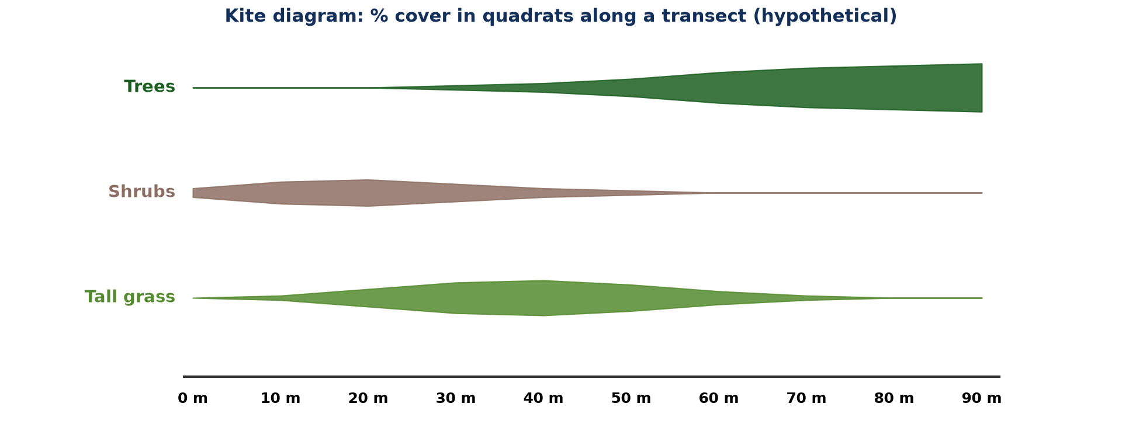
2. TRANSECT
Activity 4
Kite diagram of a transect.
Notes:
Activity 4. Look carefully at this diagram: kite diagram of a transect. Observe every detail before I ask the question.

Slide 29
2. TRANSECT
Activity 4: Question
Describe the change in trees along the transect.
Notes:
Here is the question for Activity 4: Describe the change in trees along the transect. Take one minute to think and write your answer in your rough notebook.

Slide 30
2. TRANSECT
Activity 4: Answer
Trees increase from 0 % to about 55 % cover towards 90 m.
Notes:
Let us check the answer together. Trees increase from 0 % to about 55 % cover towards 90 m.

Slide 31

3. EXPLANATION
Activity 5
Savanna vegetation.
Notes:
Activity 5. Look carefully at this picture: savanna vegetation. Observe every detail before I ask the question.

Slide 32
3. EXPLANATION
Activity 5: Question
Give two factors that explain vegetation change along a slope.
Notes:
Here is the question for Activity 5: Give two factors that explain vegetation change along a slope. Take one minute to think and write your answer in your rough notebook.

Slide 33
3. EXPLANATION
Activity 5: Answer
Soil moisture and soil depth (also grazing and fire).
Notes:
Let us check the answer together. Soil moisture and soil depth (also grazing and fire).

Slide 34
BOARD SUMMARY
Board Summary
Topic: Fieldwork in Geography
Sub-topic: Field investigations in physical geography
Field Work 5: Fieldwork in Biogeography: Soils and Vegetation
Notes:
Now we are going to copy the board summary. Write the title and the headings neatly in your notebooks. I will give you enough time for each slide, so do not rush.

Slide 35
BOARD SUMMARY
1. Soil Profile and Soil Variation
Soils are studied in the field as follows:
Soil profile: A soil pit shows the horizons: topsoil (A), subsoil (B), weathered rock (C) and bedrock. Each horizon is measured and described.
Notes:
Let us copy Soil Profile and Soil Variation. Soils are studied in the field as follows. On this slide we have Soil profile. Write each point on a new line, with the key term first, and explain it in your own words when we revise. When you finish, we go to the next slide.

Slide 36
BOARD SUMMARY
1. Soil Profile and Soil Variation (continued)
Soil properties: Colour, texture, pH, depth and moisture are tested with an auger and simple kits. Changes with depth or along a slope are recorded.
Soil erosion: Exposed roots, rills and gullies show erosion. Their size and the plant cover are noted.
Notes:
We continue with Soil Profile and Soil Variation. On this slide we have Soil properties and Soil erosion. Write each point on a new line, with the key term first, and explain it in your own words when we revise.

Slide 37
BOARD SUMMARY
1. Soil Profile and Soil Variation
Illustration: a soil profile
Notes:
Now draw this illustration in your notebook: a soil profile. Give it a title and label it clearly.

Slide 38
BOARD SUMMARY
2. Vegetation along a Transect
Vegetation is studied as follows:
Quadrat: It is a square frame, often 1 m², placed at regular points. The species and percentage cover inside it are recorded.
Notes:
Let us copy Vegetation along a Transect. Vegetation is studied as follows. On this slide we have Quadrat. Write each point on a new line, with the key term first, and explain it in your own words when we revise. When you finish, we go to the next slide.

Slide 39
BOARD SUMMARY
2. Vegetation along a Transect (continued)
Transect: It is a line across an area along which quadrats are placed. It shows how vegetation changes, for example from a stream to a hilltop.
Kite diagram: It shows the percentage cover of each species along the transect. Wide sections show high cover.
Notes:
We continue with Vegetation along a Transect. On this slide we have Transect and Kite diagram. Write each point on a new line, with the key term first, and explain it in your own words when we revise.

Slide 40
BOARD SUMMARY
2. Vegetation along a Transect
Illustration: kite diagram of a transect
Notes:
Now draw this illustration in your notebook: kite diagram of a transect. Give it a title and label it clearly.

Slide 41
BOARD SUMMARY
3. Explanation
Vegetation changes are explained by the following factors:
Physical factors: Soil moisture, soil depth and slope change along the transect. Wet soils near streams support trees.
Notes:
Let us copy Explanation. Vegetation changes are explained by the following factors. On this slide we have Physical factors. Write each point on a new line, with the key term first, and explain it in your own words when we revise. When you finish, we go to the next slide.

Slide 42
BOARD SUMMARY
3. Explanation (continued)
Human factors: Grazing, trampling and fire reduce plant cover. Protected areas show denser vegetation.
Notes:
We continue with Explanation. On this slide we have Human factors. Write each point on a new line, with the key term first, and explain it in your own words when we revise.

Slide 43
FORMATIVE EVALUATION
Evaluation 1
Give the steps of a transect survey.
Notes:
Now let us check what you have understood. Question 1: Give the steps of a transect survey. Answer in your exercise book.

Slide 44
FORMATIVE EVALUATION
Expected Answer
Lay a tape, place quadrats at intervals, record species and cover.
Notes:
The expected answer is: lay a tape, place quadrats at intervals, record species and cover. If you got it right, well done.

Slide 45
FORMATIVE EVALUATION
Evaluation 2
Name two soil tests done in the field.
Notes:
Now let us check what you have understood. Question 2: Name two soil tests done in the field. Answer in your exercise book.

Slide 46
FORMATIVE EVALUATION
Expected Answer
Texture and pH.
Notes:
The expected answer is: texture and pH. If you got it right, well done.

Slide 47
REMEDIATION
Remediation
Fill in the blanks:
Topsoil is the ______ horizon.
A square sampling frame is a ______.
Cover along a transect is shown by a ______ diagram.
Notes:
For those who need more practice, fill in the blanks in your exercise book. The answers are: number 1, A; number 2, quadrat; number 3, kite.

Slide 48
HOMEWORK
Homework
Make a 1 m quadrat and record the plants in three places around the school.
Notes:
For your homework: Make a 1 m quadrat and record the plants in three places around the school. We shall correct it at the beginning of our next lesson.

Slide 49
NEXT LESSON
Next Lesson
Our next lesson will be on:
Field Work 6: Fieldwork on Economic Activities
Notes:
Our next lesson will be on Field Work 6: Fieldwork on Economic Activities. Thank you for your attention, and see you next time.

Slide 50
BILINGUAL GAME
Bilingual Game (Jeu Bilingue)
English | Français
Soil | Le sol
Horizon | L'horizon
Quadrat | Le quadrat
Transect | Le transect
Cover | Le recouvrement
Species | L'espèce
Notes:
Let us play the bilingual game. I say a word in English, and you give me the French word. Then we do the reverse.

Slide 51
LOGBOOK
Official Logbook (1/2)
Module / Topic | Fieldwork in Geography
Lesson Title | Field Work 5: Fieldwork in Biogeography: Soils and Vegetation
Expected Learning Outcomes | Describe a soil profile and test soil properties. Sample vegetation with quadrats along a transect. Present results with a kite diagram.
Competence | Learners are able to describe soil profiles and sample vegetation along a transect.
Notes:
I record this information in the official logbook of the class after the lesson.

Slide 52
LOGBOOK
Official Logbook (2/2)
Matter Taught | Soil Profile and Soil Variation; Vegetation along a Transect; Explanation.
Evaluation | Formative evaluation and remediation exercise.
Homework | Make a 1 m quadrat and record the plants in three places around the school.
Enrolment / Present / Absent | ____ / ____ / ____
Achievement | To be completed after the lesson.
Notes:
I complete the second page of the logbook: the matter taught, the evaluation, the homework and the attendance.

Slide 53
TEACHER'S NOTE
Teacher's Note
Timing: Homework correction, plan, objectives 8 min | Recall, situation, action 10 min | 5 activities 30 min | Board summary (copying) 30 min | Evaluation, remediation 10 min | Homework, next lesson 5 min | Logbook 7 min
Without the projector (Activity 1): describe a soil pit.
Without the projector (Activity 2): test a sample.
Without the projector (Activity 3): make a quadrat.
Without the projector (Activity 4): read the diagram.
Without the projector (Activity 5): explain the pattern.
Notes:
This slide is for me, the teacher: it gives the timing of the lesson and what to do if the projector is not available.

Slide 54
REFERENCES
References
National Geography Syllabus, MINESEC/IGE/IP-SS, 2019 — Module 8 (Practical Geography).
Photo, Activity 2: “Soil Auger sample” by SAGT, CC BY-NC-SA 2.0, via Flickr (https://www.flickr.com/photos/46860625@N07/4971829421)
Photo, Activity 3: “Vegetation Monitoring, Katmai NPP” by swanNPS, CC BY-NC 2.0, via Flickr (https://www.flickr.com/photos/90673956@N06/16796099732)
Photo, Activity 5: “Blue Wildebeest in the Lowveld” by Martin_Heigan, CC BY-NC-ND 2.0, via Flickr (https://www.flickr.com/photos/97303475@N00/2089079933)
Diagrams and animations: drawn for this lesson (Geography Department).
Notes:
These are the references and picture credits used to prepare this lesson.

